Slide 1
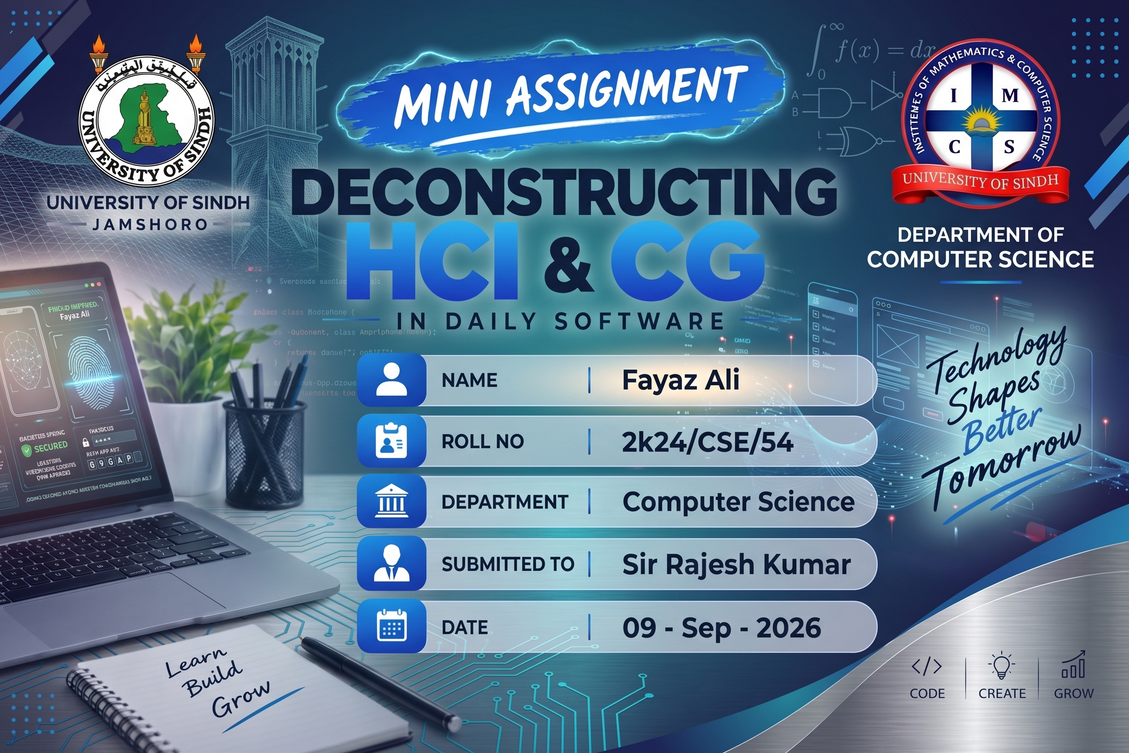

Slide 2
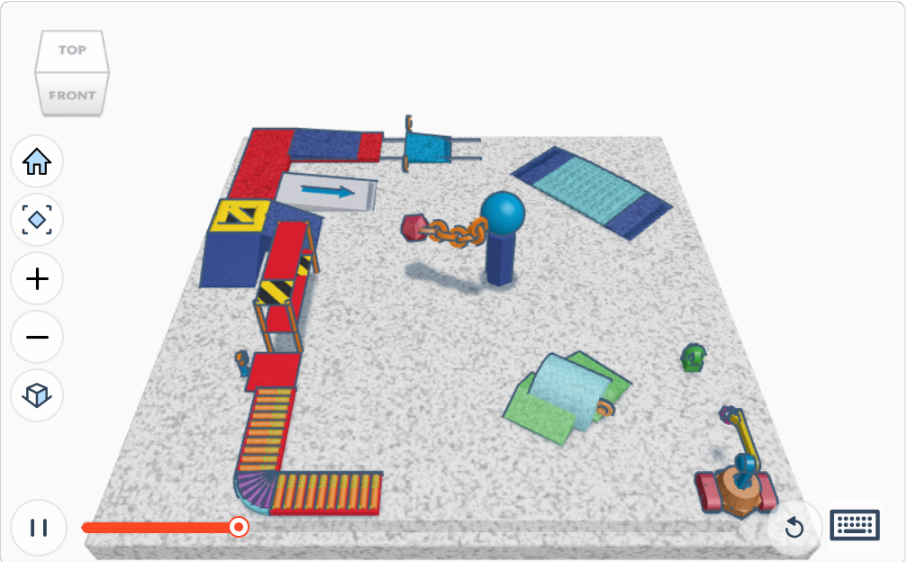
Slide 1 — HCI Focus: Interaction Elements in Tinkercad
1
2
3
1. View Navigation Cube
2. Left-Side Toolbar
3. Playback Controls
Clicking directly on a labeled face like “TOP” or “FRONT” snaps the camera straight to that standard view, instead of manually dragging to line the model up.
Home, orbit, zoom in/out, and the view-type toggle all sit in one vertical stack, so a beginner never has to hunt for a keyboard shortcut to move around the scene.
The pause button and the red scrubber let you step through the build frame by frame, giving direct control over exactly which stage of the model you're looking at.
Fayyaz Bozdar | 2k24/CSE/54 | HCI and Computer Graphics

Slide 3
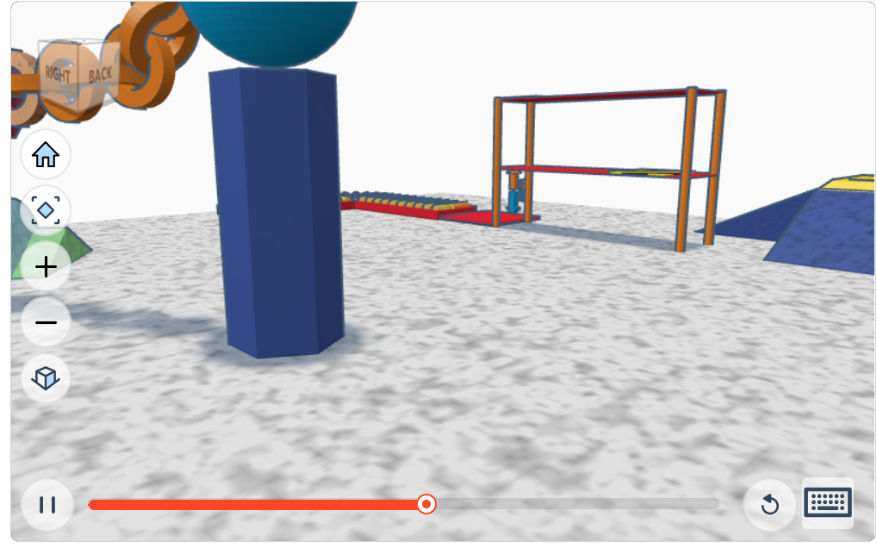
Slide 2 — CG Focus: Rendering / Visual Elements in Tinkercad
1
2
3
1. 3D Mesh Geometry
2. Lighting & Surface Shading
3. Perspective Camera View
The prism and sphere are built from flat polygon faces joined at edges and vertices — you can actually see individual facets on the “curved” sphere, a giveaway that it's a low-poly mesh, not a true smooth curve.
Each beam of the orange rack has a brighter top/front face and a darker side face — basic diffuse lighting, where the renderer shades every flat polygon differently depending on its angle to the light source.
The yellow-topped ramp in the distance renders smaller and flatter than the objects up front, and the scene narrows toward the horizon — the signature of a perspective projection, not a flat orthographic view.
Fayyaz Bozdar | 2k24/CSE/54 | HCI and Computer Graphics

Slide 4
Reflection Questions
Q1. How does the Computer Graphics quality help or hinder the user's ability to interact with the software?
Good shading and shadows make it much easier to tell how objects sit relative to each other in a cluttered scene like this — without them, it would be hard to tell what's resting on the ground and what's floating. The trade-off is that the low-poly, flat-shaded style makes curved surfaces like the sphere look a bit blocky up close, which can make precise alignment slightly harder to judge.
Q2. What is one simple HCI change you would make to improve the user interface?
One simple fix would be giving the left-side toolbar icons a small permanent text label instead of relying only on a hover tooltip, since icons like the view-type toggle aren't immediately obvious to a first-time user.
Fayyaz Bozdar | 2k24/CSE/54 | HCI and Computer Graphics

